Slide 1
DNA Strand Infographics
Here is where this template begins

Slide 2
DNA strand infographics
01
Sugar
Neptune is the farthest planet from the Sun
02
Phosphate
DNA
Polymer made of nucleotides
Mercury is the closest planet to the Sun
03
Base
Despite being red, Mars is a cold place

Slide 3
DNA strand infographics
Adenine
01
02
Thymine
Jupiter is a gas giant and the biggest planet
Neptune is the farthest planet from the Sun
Guanine
03
04
Cytosine
Mercury is the closest planet to the Sun
Despite being red, Mars is a cold place

Slide 4
DNA strand infographics
Transcription
Translation
DNA
RNA
Protein
Jupiter is the biggest planet in the Solar System
Venus is the second planet from the Sun
Despite being red, Mars is a very cold place

Slide 5
DNA strand infographics
Amino acids
01
Jupiter is a gas giant and the biggest planet
Proteins
02
Venus is the second planet from the Sun

Slide 6
DNA strand infographics
Sugar phosphate backbone
5-carbon deoxyribose sugars and phosphate groups
3.4 nm
Extremely important in the function of DNA

Slide 7
DNA strand infographics
Nucleobases of DNA
01
02
03
04
Adenine
Guanine
Thymine
Cytosine
Mercury is the closest planet to the Sun
Despite being red, Mars is a cold place
Jupiter is a gas giant and the biggest planet
Neptune is very far away from Earth

Slide 8
DNA strand infographics
Deoxyribonucleic acid
Nucleobases of DNA
DNA
Base pair
Thymine
Adenine
Sugar phosphates helix
Guanine
Cytosine

Slide 9
DNA strand infographics
Carbon
Hydrogen
Oxygen
Nitrogen
Phosphorus
Thymine (T)
Adenine (A)
Cytosine (C)
Guanine (G)

Slide 10
DNA strand infographics
20%
30%
40%
Jupiter
Venus
Mars
Jupiter is a gas giant and the biggest planet
Venus is the second planet from the Sun
Despite being red, Mars is a very cold place

Slide 11
DNA strand infographics
Thymine
01
02
Adenine
Jupiter is a gas giant and the biggest planet
Neptune is the farthest planet from the Sun
20%
10%
Guanine
03
04
Cytosine
Mercury is the closest planet to the Sun
Despite being red, Mars is a cold place
30%
Structure & function
40%

Slide 12
DNA strand infographics
DNA structure
60%
40%
Major groove
Minor groove
Mercury is the closest planet to the Sun
Despite being red, Mars is a cold place

Slide 13
DNA strand infographics
DNA strand through the microscope
Mercury is the closest planet to the Sun and the smallest one of all the planets in the Solar System. This planet's name has nothing to do with the liquid metal
Strand
Basis
Strand

Slide 14
DNA strand infographics
4
Thymine
Adenine
Bases of DNA
Mercury is the closest planet to the Sun and the smallest one in the entire Solar System
Guanine
Cytosine

Slide 15
DNA strand infographics
01
02
Strand name
Strand name
Plus positive sense
Minus negative antisense
Mercury is the closest planet to the Sun
Despite being red, Mars is a cold place

Slide 16
DNA strand infographics
01
Base pair
Jupiter is a gas giant and the biggest planet
02
Sugar phosphate backbone
Mercury is the closest planet to the Sun
03
Nitrogenous pair
Venus is the second planet from the Sun

Slide 17
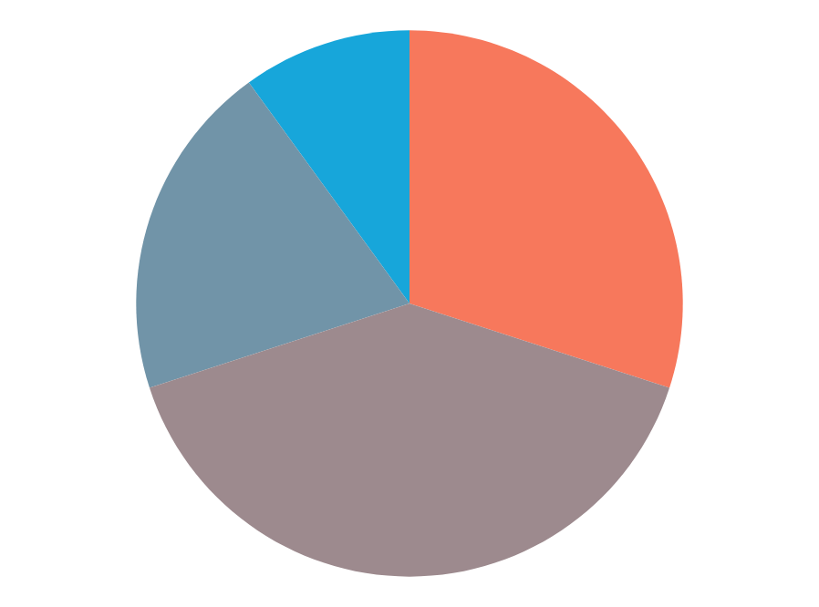
DNA strand infographics
10%
30%
Thymine
Adenine
Jupiter is a gas giant and the biggest planet
Neptune is the farthest planet from the Sun
20%
40%
Guanine
Cytosine
Mercury is the closest planet to the Sun
Despite being red, Mars is a cold place
Follow the link in the graph to modify its data and then paste the new one here. For more info, click here

Slide 18
DNA strand infographics
Where do you find the DNA in plant cells?
Nucleus
Mitochondria
Chloroplasts
Mercury is the closest planet to the Sun
Venus is the second planet from the Sun
Pluto is considered a dwarf planet

Slide 19
DNA strand infographics
01
02
03
04
Mercury
Mars
Jupiter
Neptune
Mercury is the closest planet to the Sun
Despite being red, Mars is a cold place
Jupiter is a gas giant and the biggest planet
It’s the farthest planet from the Sun

Slide 20
DNA strand infographics
01
02
Jupiter
Neptune
Jupiter is a gas giant and the biggest planet
Neptune is the farthest planet from the Sun
03
04
Mercury
Mars
Mercury is the closest planet to the Sun
Despite being red, Mars is a cold place

Slide 21
DNA strand infographics
Earth
Earth is the third planet from the Sun and the only one that harbors life in the System
40%
60%
Mercury
Mercury is the closest planet to the Sun and the smallest one in the entire Solar System

Slide 22
DNA strand infographics
01
Neptune
Neptune is the farthest planet from the Sun
02
Jupiter
Jupiter is a gas giant and the biggest planet
03
Mars
Despite being red, Mars is a cold place
04
Pluto
Pluto is considered a dwarf planet
05
Venus
Venus is the second planet from the Sun

Slide 23
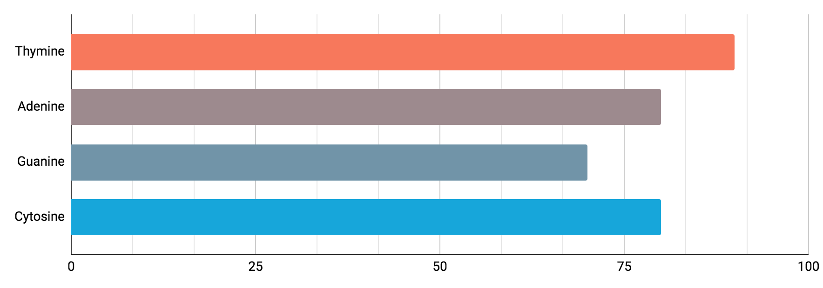
DNA strand infographics
100%
80%
70%
80%
Nucleobases of DNA
Mercury is the closest planet to the Sun and the smallest one of all the planets in the Solar System. This planet's name has nothing to do with the liquid metal
Follow the link in the graph to modify its data and then paste the new one here. For more info, click here

Slide 24
DNA strand infographics
100%
50%
20%
01
02
03
Mercury
Venus
Pluto
Mercury is the closest planet to the Sun
Venus is the second planet from the Sun
Pluto is considered a dwarf planet

Slide 25
DNA strand infographics
Mercury
Mercury is the closest planet to the Sun
Venus
Venus is the second planet from the Sun

Slide 26
DNA strand infographics
01
02
Thymine
Adenine
Jupiter is a gas giant and the biggest planet
Neptune is the farthest planet from the Sun
03
04
Guanine
Cytosine
Mercury is the closest planet to the Sun
Despite being red, Mars is a cold place

Slide 27
DNA strand infographics
02
Venus
Venus is the second planet from the Sun
01
Mercury
03
Pluto
Mercury is the closest planet to the Sun
Pluto is considered a dwarf planet

Slide 28
DNA strand infographics
01
Neptune
Neptune is the farthest planet from the Sun
02
Jupiter
Jupiter is a gas giant and the biggest planet
Mars
Despite being red, Mars is a cold place
03
04
Pluto
Pluto is considered a dwarf planet
05
Venus
Venus is the second planet from the Sun

Slide 29
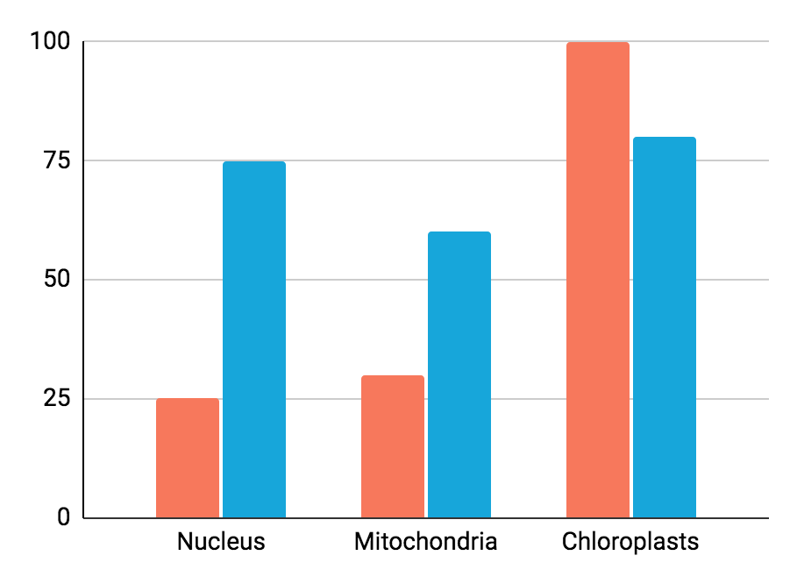
DNA strand infographics
01
Plus positive sense
Mercury is the closest planet to the Sun
02
Minus negative antisense
Despite being red, Mars is a cold place
Follow the link in the graph to modify its data and then paste the new one here. For more info, click here

Slide 30
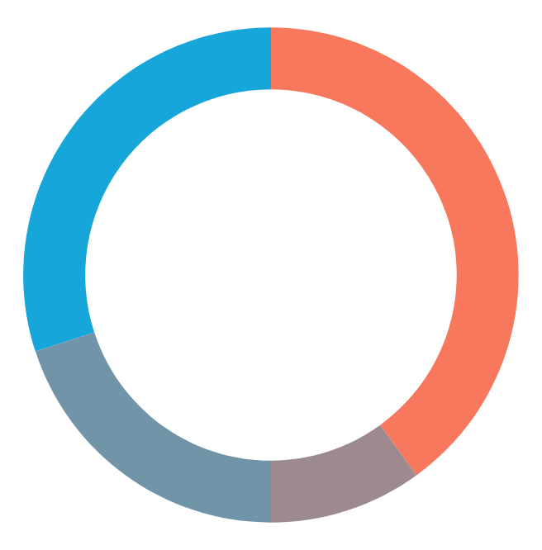
DNA strand infographics
40%
10%
Thymine
Adenine
Jupiter is a gas giant and the biggest planet
Neptune is the farthest planet from the Sun
20%
30%
Guanine
Cytosine
Mercury is the closest planet to the Sun
Despite being red, Mars is a cold place
Follow the link in the graph to modify its data and then paste the new one here. For more info, click here

Slide 31
DNA strand infographics
Main functions of DNA
01 | Replication | Neptune is the farthest planet from the Sun
02 | Encoding information | Jupiter is a gas giant and the biggest planet
03 | Recombination | Despite being red, Mars is a cold place
04 | Gene expression | Pluto is considered a dwarf planet

Slide 32
DNA strand infographics
Replication
Mutation
Polypeptides
Jupiter is a gas giant and the biggest planet
Mercury is the closest planet to the Sun
Expression
Recombination

Slide 33
Instructions for use (premium users)
As a Premium user, you can use this template without attributing Slidesgo.
You are allowed to:
Modify this template.
Use it for both personal and commercial purposes.
Hide or delete the “Thanks” slide and the mention to Slidesgo in the credits.
Share this template in an editable format with people who are not part of your team.
You are not allowed to:
Sublicense, sell or rent this Slidesgo Template (or a modified version of this Slidesgo Template).
Distribute this Slidesgo Template (or a modified version of this Slidesgo Template) or include it in a database or in any other product or service that offers downloadable images, icons or presentations that may be subject to distribution or resale.
Use any of the elements that are part of this Slidesgo Template in an isolated and separated way from this Template.
Register any of the elements that are part of this template as a trademark or logo, or register it as a work in an intellectual property registry or similar.
For more information about editing slides, please read our FAQs or visit Slidesgo School:
https://slidesgo.com/faqs and https://slidesgo.com/slidesgo-school

Slide 34
Infographics
You can add and edit some infographics to your presentation to present your data in a visual way.
Choose your favourite infographic and insert it in your presentation using Ctrl C + Ctrl V or Cmd C + Cmd V in Mac.
Select one of the parts and ungroup it by right-clicking and choosing “Ungroup”.
Change the color by clicking on the paint bucket.
Then resize the element by clicking and dragging one of the square-shaped points of its bounding box (the cursor should look like a double-headed arrow). Remember to hold Shift while dragging to keep the proportions.
Group the elements again by selecting them, right-clicking and choosing “Group”.
Repeat the steps above with the other parts and when you’re done editing, copy the end result and paste it into your presentation.
Remember to choose the “Keep source formatting” option so that it keeps the design. For more info, please visit Slidesgo School.

